Slide 1




X
Welcome to the Smart Farming Era

Slide 2

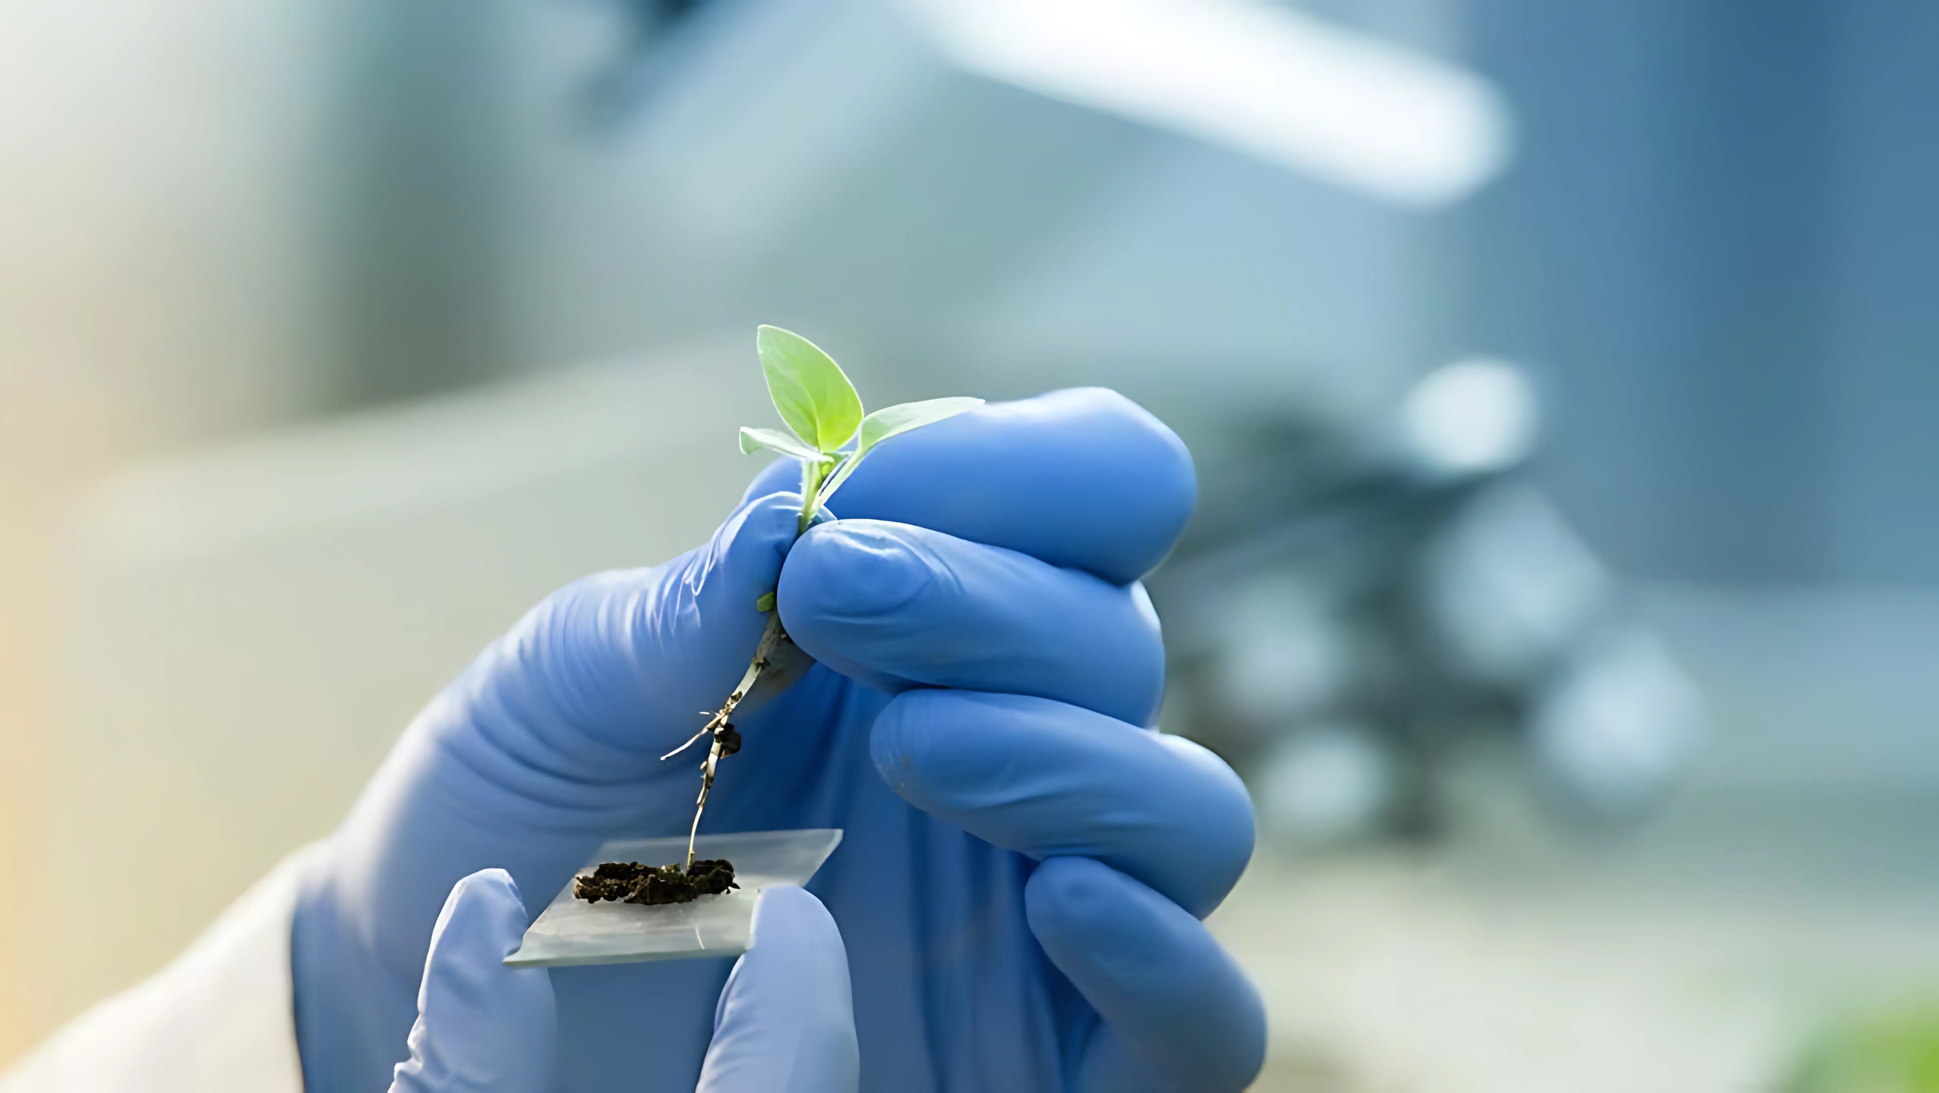


Farmers struggle to select effective treatments
Notes:
- Farmers face challenges in selecting the right crop treatments
- Due to lack of data on their efficacy across varying climates and soil conditions
- Resulting in suboptimal yields and increased vulnerability to environmental threats.
- We are providing an AI driven agricultural solution

Slide 3








Our Solution
Data Retrieval
Web Application
AI Model
Notes:
- Downloaded all the historical data for wheather forecasts of the last 50 years
- Used them to train an AI Mixture of Experts model to predict risks for crops for the next weeks
- Created a web application to let the farmer be informed by AI predictions

Slide 4


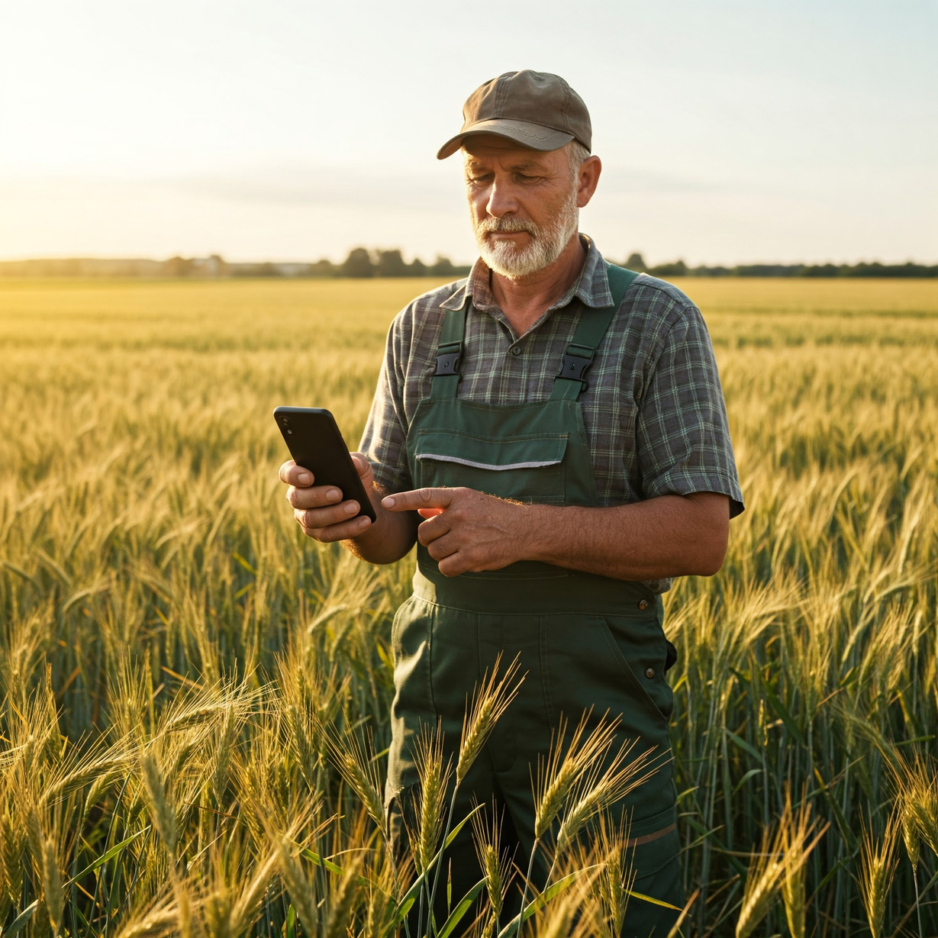




Not your Grandfather’s Farm Tools:
ML-Powered Results
Training on historical data
Rolling window of two years to consider climate trends
Near perfect accuracy
Prediction of future temperature related stress with >99% accuracy
Lighting-fast inference
Lightweight models
Heavy caching
Notes:
- Models based on agronomy stress algorithms
- Lightweight models -> they may run on client side to save server time = money + pollution

Slide 5
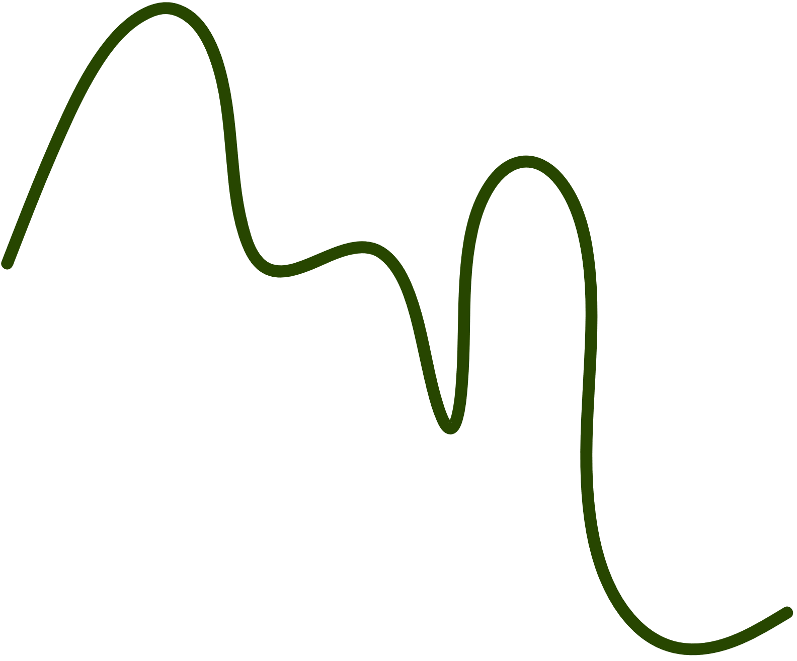


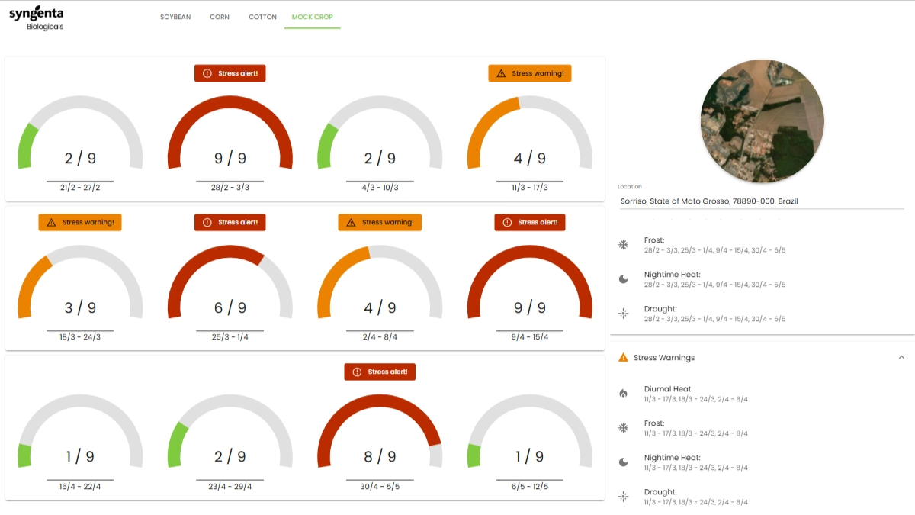

DEMO

Slide 6
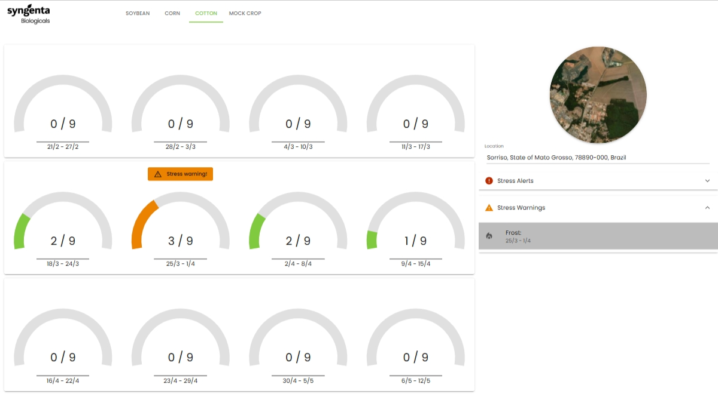
DEMO

Slide 7
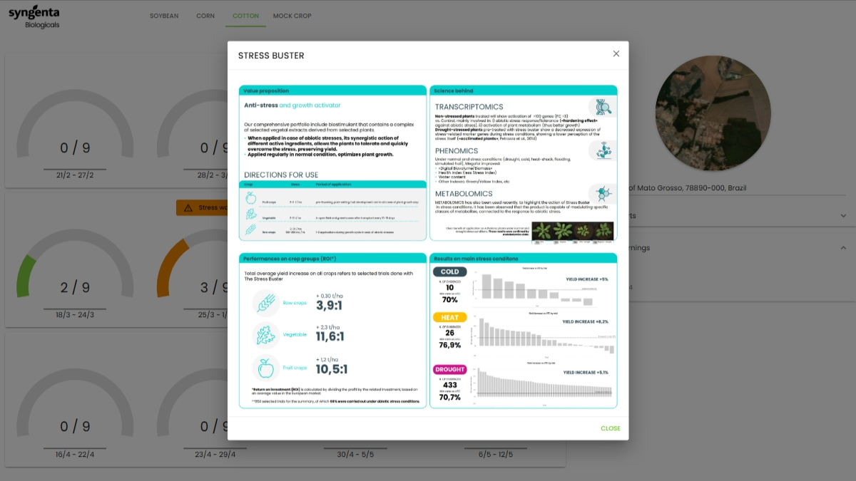
DEMO

Slide 8





Results
Data Visualization
Decision Support Tool
Conversion Funnel
Empower the farmer through AI based suggestions,
boosting biologicals efficacy
Provide farmers a useful tool resulting in customer fidelization and increased sales
Dashboard of incoming risks

